Slide 1

Department of Information Technology
A Multi-Model Deep Learning Framework for Real-Time Road Damage Detection and Severity Classification
Batch no - 09
2211IT010045 – K. Chinmayee
2211IT010034 - D. Sai Sindhu
2211IT010044 - J. Arun
2211IT010050 - K. Sandeep
Guide: Dr. L. Neelu
Maisammaguda, Kompally, Medchal - Malkajgiri District Hyderabad - 500100, Telangana State. www.mallareddyuniversity.
(Telangana State Private Universities Act No. 13 of 2020 &
G.O.Ms. No. 14, Higher Education (UE) Department)

Slide 2
CONTENTS
Project Title & Abstract
Introduction
Literature Review Document
Proposed Solution
Detailed Methodology
Implementation Evidence
Technology Stack
Complete Implementation
Results & Analysis
Discussion
Conclusion

Slide 3
PROJECT TITLE & ABSTRACT
PROJECT TITLE:
A Multi-Model Deep Learning Framework for Real-Time Road Damage Detection and Severity Classification
ABSTRACT:
This project develops an AI-based road damage detection system using a multi-model deep learning approach. It utilizes a YOLO model for real-time pothole detection and a CNN model for classifying damage severity into Low, Medium, and High levels. The system processes road images through a web-based interface and provides instant, structured results to users. By integrating detection, classification, and visualization, the system enables efficient road monitoring and supports data-driven maintenance decisions. This solution demonstrates how computer vision and deep learning can be applied to improve infrastructure safety and smart city development.

Slide 4
INTRODUCTION - BACKGROUND
Analyzing road conditions using computer vision helps identify damages that impact safety and transportation efficiency. Traditional inspection methods are manual, time-consuming, and prone to errors. This project applies advanced deep learning techniques to automatically detect road damages and classify their severity, presenting the results through a web-based interface for real-time monitoring and decision-making.
Key Points –
Increasing road damage issues affecting safety
Need for automated road inspection systems
Role of deep learning in image-based detection
Importance of real-time and accessible solutions

Slide 5
INTRODUCTION – PROBLEM DEFINITION
Traditional road inspection methods rely on manual surveys or sensor-based systems, which are time-consuming, costly, and inefficient. Most existing solutions focus only on detecting potholes without considering the severity of the damage. Additionally, many systems fail to provide real-time results and require expensive hardware, limiting their practical deployment. This project addresses these challenges by developing an AI-based system that performs both detection and severity classification with real-time, web-based output for better road maintenance planning.

Slide 6
INTRODUCTION – OBJECTIVES
The project objectives define the key goals for developing an efficient AI-based road damage detection system. The aim is to build a complete pipeline from image input to real-time detection and severity classification, ensuring practical deployment for road monitoring.
Key Points –
Collect and preprocess road image datasets
Build YOLO-based pothole detection model
Develop CNN-based severity classification (Low/Medium/High)
Enable real-time detection through web interface
Integrate frontend, backend, and database
Evaluate system performance using metrics

Slide 7
INTRODUCTION – SCOPE & LIMITATIONS
SCOPE
Image-based road damage detection system
YOLO for real-time pothole detection
CNN for severity classification (Low/Medium/High)
Web-based interface for result visualization
LIMITATIONS
Performance affected by poor lighting and weather conditions
No depth-based damage estimation (only 2D images)
Accuracy depends on dataset quality and diversity
Requires computational resources for model execution

Slide 8
LITERATURE REVIEW DOCUMENT
Real Time Pothole Detection Using YOLO Algorithm (2025) : It highlights how automated systems can replace manual inspection methods.
YOLOv8-based Pothole Detection: A Real-time Approach (2025) : This study applies YOLOv8 for fast and accurate pothole detection in real-world scenarios. It emphasizes the importance of computer vision in infrastructure monitoring.
A Deep Learning Model for Pothole Detection (2024) : This paper uses deep learning models to detect potholes with good accuracy and real-time performance. It achieves around 82% accuracy and supports live video-based detection.
POT-YOLO: Real-Time Road Pothole Detection using YOLOv8 (2024) : This research proposes an improved YOLOv8 model for detecting different types of road damages. It achieves high precision and improves detection performance in complex environments.

Slide 9
RESEARCH GAP
Existing studies on road damage detection mainly focus on identifying potholes without considering severity classification. Many approaches lack real-time processing and require expensive hardware, making them less practical for large-scale deployment. Additionally, limited integration with web-based systems reduces accessibility and usability. This project addresses these gaps by combining YOLO-based detection with CNN-based severity classification and providing real-time results through a web-enabled interface.

Slide 10
PROPOSED SOLUTION
The proposed system follows an end-to-end pipeline that processes road images using deep learning models to detect damages and classify their severity. It integrates a YOLO model for real-time pothole detection and a CNN model for severity classification, delivering results through a web-based interface for efficient and user-friendly monitoring.
Key Points –
Road image collection (upload/capture)
Image preprocessing and normalization
YOLO-based pothole detection
CNN-based severity classification
Web interface for result visualization

Slide 11
DETAILED METHODOLOGY
The methodology focuses on building a structured deep learning pipeline that processes road images to detect damages and classify their severity. The system uses a YOLO model for accurate pothole detection and a CNN model for classifying severity levels, with results displayed through a web-based interface.
Key Points –
Image collection and preprocessing (resizing, normalization)
Feature extraction using deep learning models
YOLO model for pothole detection
CNN model for severity classification
Web interface integration for result visualization

Slide 12
DETAILED METHODOLOGY - ALGORITHM
Input & Preprocessing
Pothole Detection (YOLO)
severity Classification (CNN)
Output & Storage

Slide 13
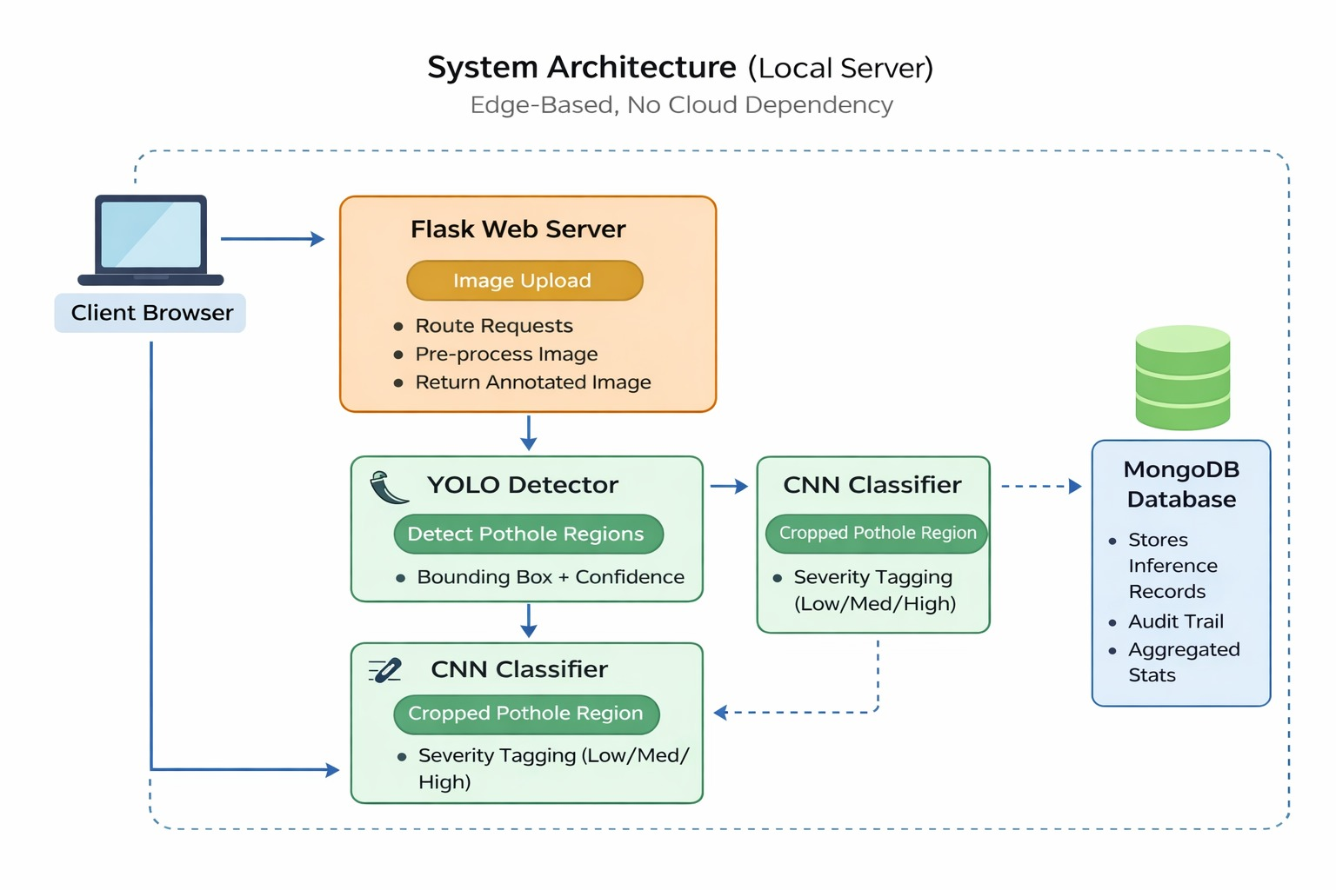
DETAILED METHODOLOGY – SYSTEM ARCHITECTURE

Slide 14
IMPLEMENTATION EVIDENCE
Module | Implementation Status
Image Upload Module | Validates image format and size successfully
Image Preprocessing | Resizing and normalization applied correctly
YOLO Detection Model | Accurately detects potholes with bounding boxes
ROI Extraction | Detected regions extracted efficiently
CNN Classification Model | Outputs stable severity predictions (Low/Medium/High)
Web Interface | Displays results in real-time
Database (MongoDB) | Ensures reliable data storage (100% write success)
System Integration | Frontend, backend, and models fully integrated

Slide 15
IMPLEMENTATION EVIDENCE - DATASET DESCRIPTION
Multiple road image datasets were used to train and evaluate the model, including publicly available datasets and real-world captured images. The images were preprocessed to remove noise, standardize resolution, and improve quality for accurate detection and classification.
The project uses deep learning models (YOLO and CNN) to detect potholes and classify their severity, converting raw road images into meaningful insights for infrastructure monitoring.
Integration of the web interface with backend and database improves accessibility and usability, allowing users to view real-time detection results and support efficient road maintenance decisions.

Slide 16
TECHNOLOGY STACK
Frontend Layer → Web Interface (HTML, CSS, JavaScript)
Backend Layer → Flask / FastAPI
AI/ML Layer → YOLO (Detection), CNN (Classification), OpenCV
Data Layer → Road Image Dataset, NumPy, Pandas
Database Layer → MongoDB

Slide 17
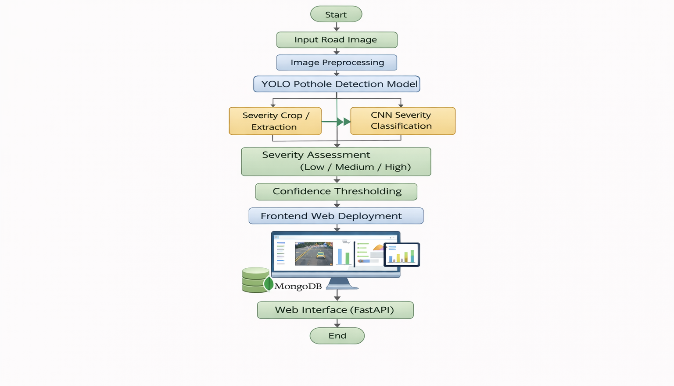
COMPLETE IMPLEMENTATION – FULLY WORKING MODEL

Slide 18
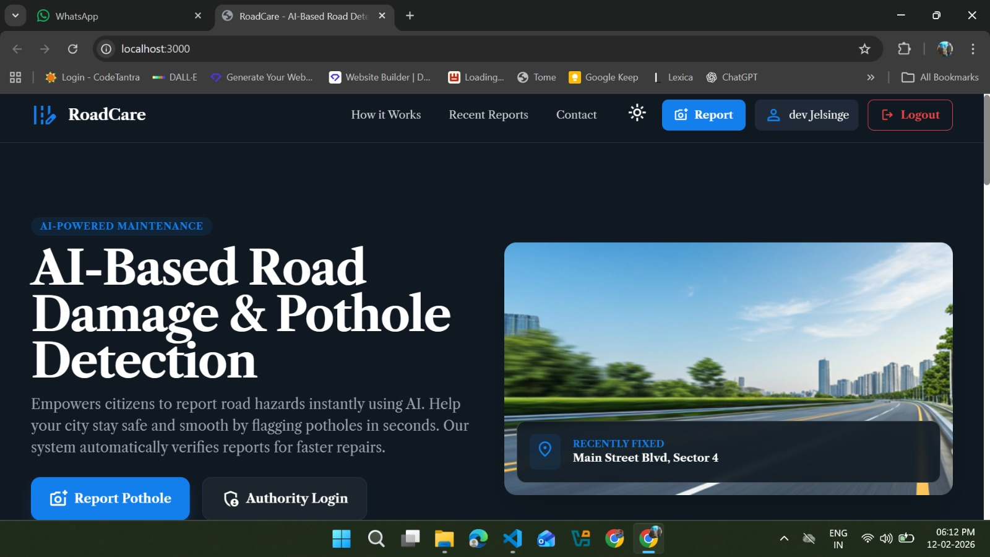
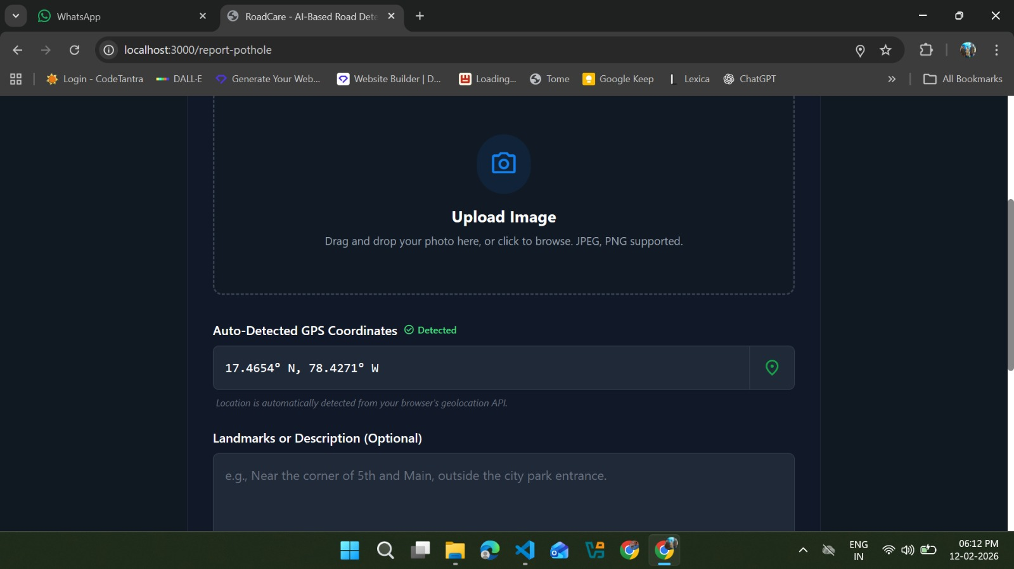
COMPLETE IMPLEMENTATION – FINAL SCREENSHOTS

Slide 19
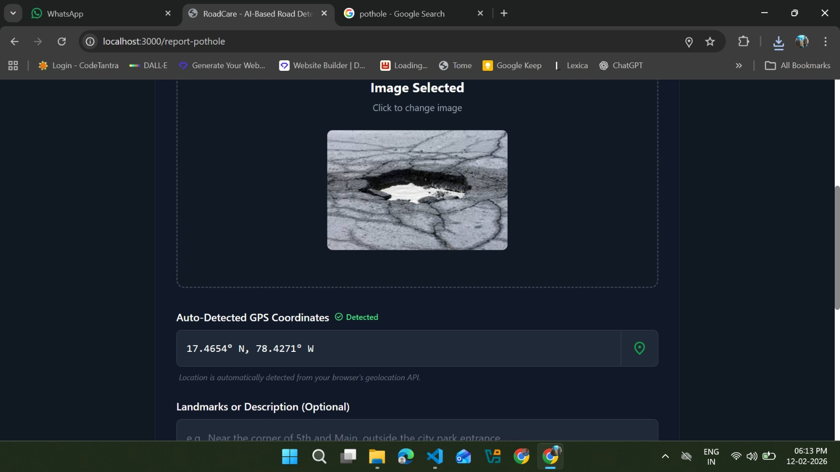
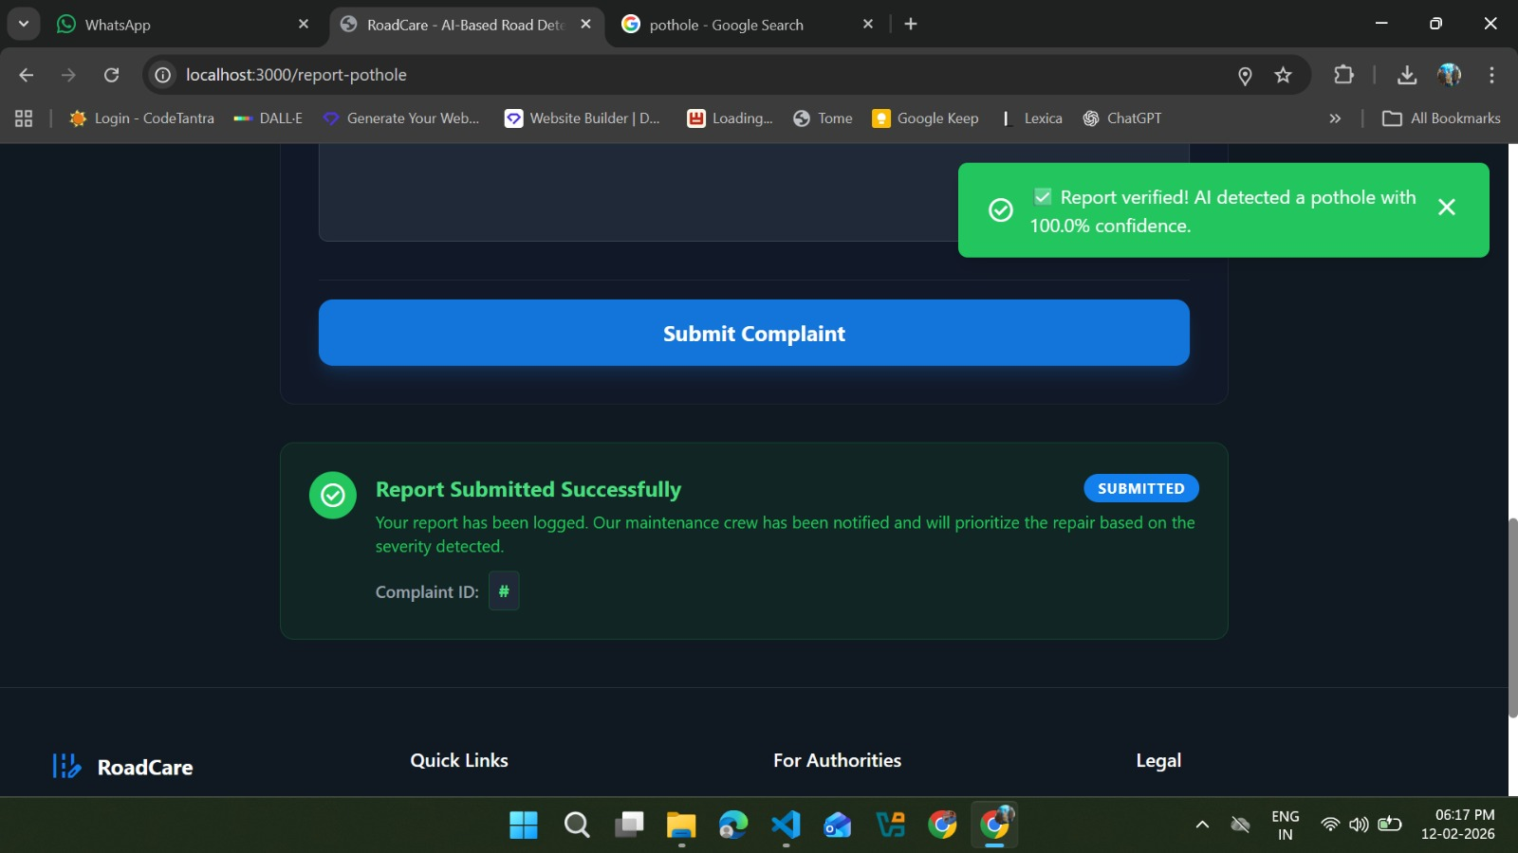

Slide 20
RESULT & ANALYSIS – QUANTITATIVE RESULTS
Quantitative evaluation performed using standard deep learning metrics:
Accuracy
Precision
Recall
F1-score
The proposed system shows effective performance in detecting potholes and classifying severity levels (Low, Medium, High) across diverse road conditions.
Results demonstrate improved efficiency and accuracy compared to traditional manual inspection methods.
Graphs and visual outputs illustrate:
Detection performance metrics (Precision–Recall, mAP)
Severity classification results (class-wise accuracy)

Slide 21
RESULT & ANALYSIS – COMPARISION WITH EXISTING METHODS
The proposed system provides both pothole detection and severity classification, unlike existing approaches that focus only on detection.
It enables better decision-making for road maintenance by identifying damage levels (Low, Medium, High).
The system supports real-time usability through web-based integration, making it more practical and scalable compared to traditional methods.

Slide 22
CONCLUSION
This project successfully implements an AI-based road damage detection system using a multi-model deep learning approach. By combining YOLO for pothole detection and CNN for severity classification, the system provides accurate and real-time results.
The integration of a web-based interface and database enables efficient monitoring and management of road conditions. The results demonstrate the effectiveness of deep learning techniques in improving road safety and supporting data-driven maintenance decisions.

Slide 23
CONCLUSION – ACHIEVEMENTS & KEY CONTRIBUTIONS
Achievement of Objectives
Successfully developed a YOLO-based pothole detection system
Implemented CNN-based severity classification (Low / Medium / High)
Integrated frontend, backend, and MongoDB for complete system deployment
Achieved reliable accuracy with real-time inference performance
Enabled structured road maintenance through severity-based analysis
Key Contributions
Designed a multi-model deep learning framework (YOLO + CNN)
Developed a real-time, web-based road damage detection system
Implemented automated pipeline from image input to result storage
Provided a scalable and cost-effective solution for smart infrastructure monitoring

Slide 24
THANK YOU

